Slide 1
Psychologie expérimentale de la mémoire: Le souvenir – encodage et récupération
MIASHS L2 SC
Attention et Mémoire IV

Slide 2
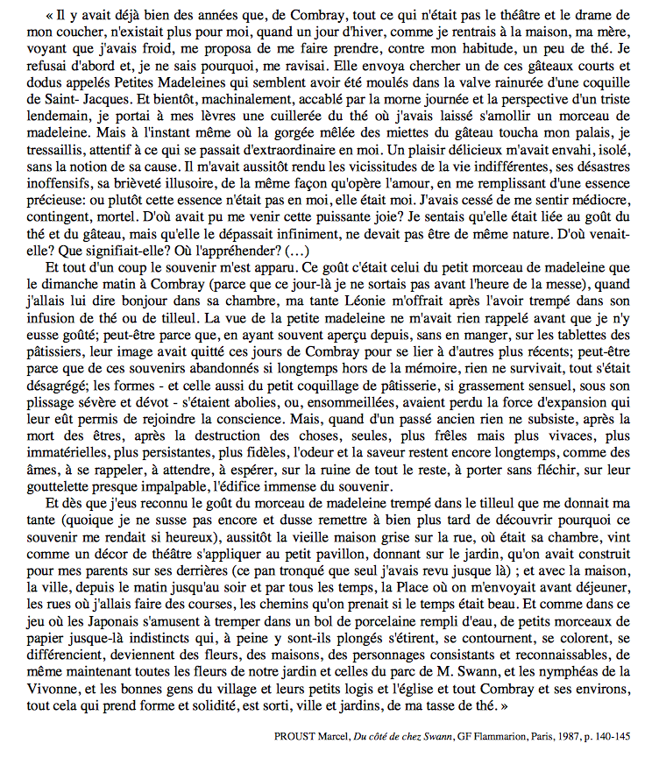

Slide 3
David Hume (1711 – 1776)
1748
1738

Slide 4
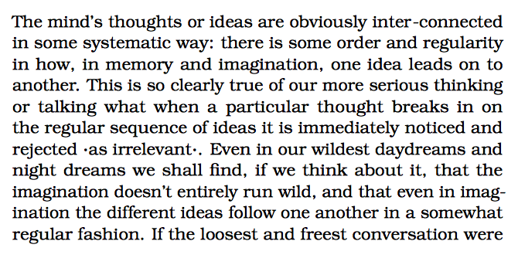
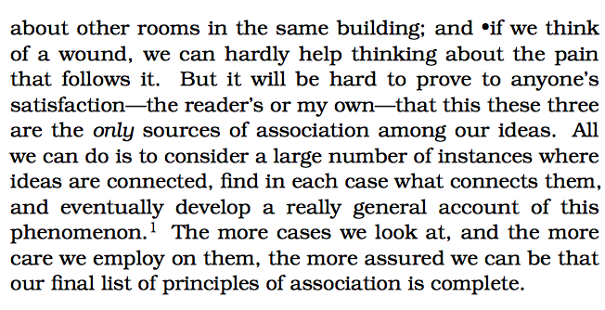
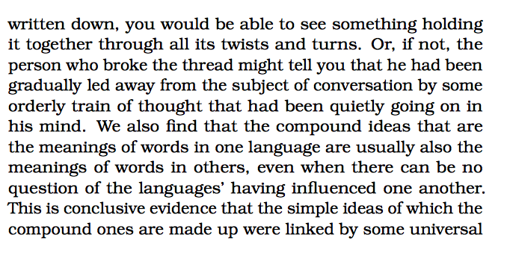
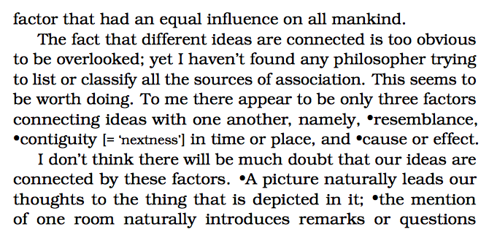

Slide 5
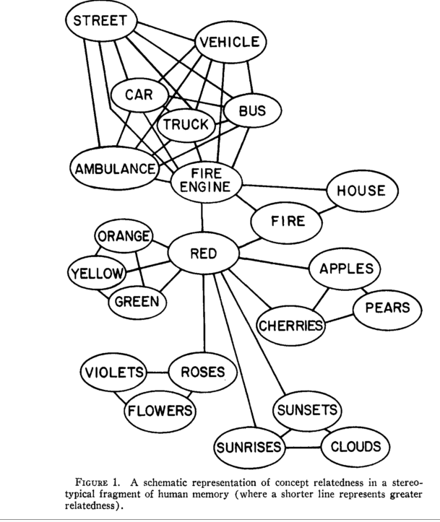
Collins & Loftus (1975). Psychological Review, 82, 407

Slide 7
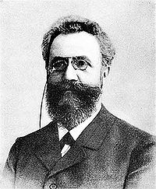
Hermann Ebbinghaus
(1850 – 1909)
Ivan Petrovitch Pavlov
(1849 – 1936)

Slide 8
Ebbinghaus (1885)

Slide 9
Ebbinghaus (1885)

Slide 10
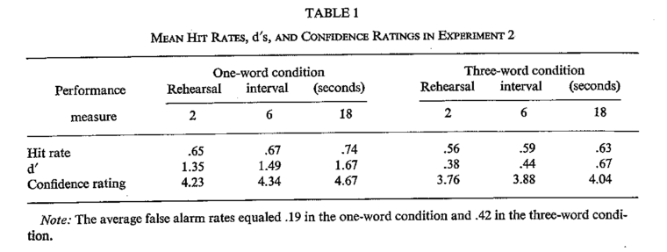
Rappel libre
2
6
18
1 mot
11%
7%
12%
3 mots
3%
4%
5%
Reconnaissance
Glenberg, Smith, & Green (1977). Journal of Verbal Learning and Verbal Behavior, 16, 339

Slide 11
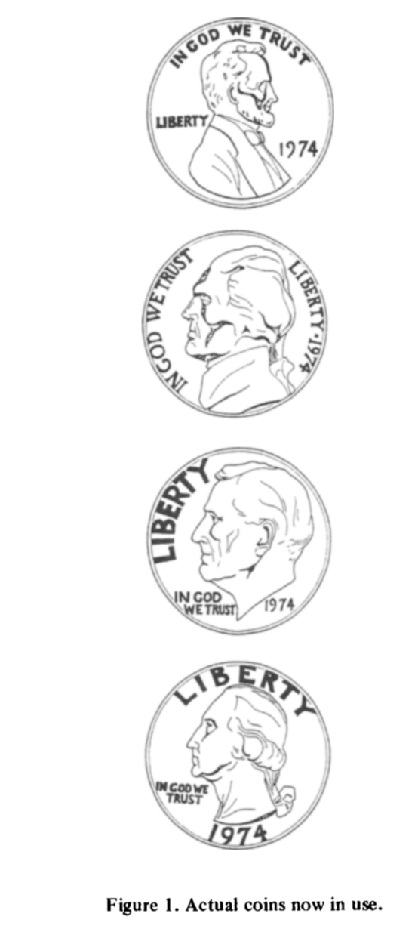
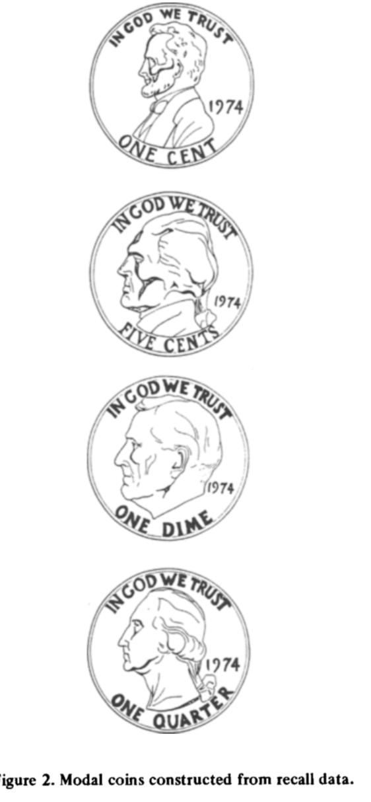
Rubin & Contis (1983). Memory & Cognition, 11.335

Slide 12
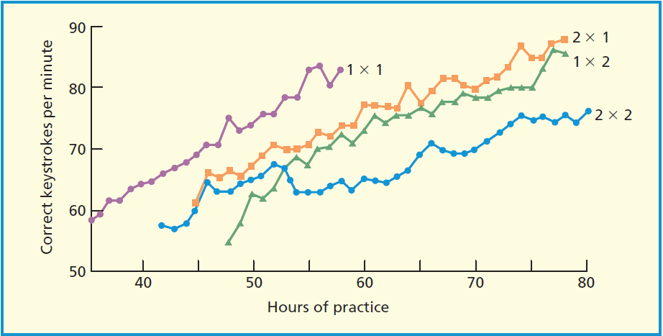
Baddeley & Longman (1978)

Slide 13
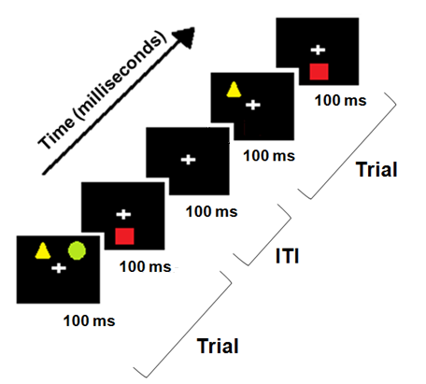
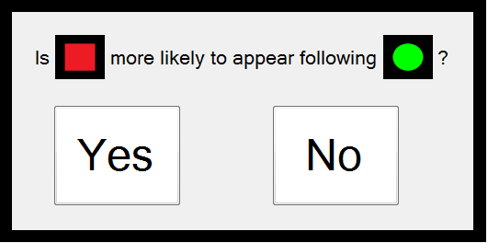
= 100 ms or 1000 ms
Streamed-trial procedure
∆P = 0, 0.4
X 10

Slide 14
(Error-bars are 95% CI)
n = 17 in all 3 studies

Slide 15
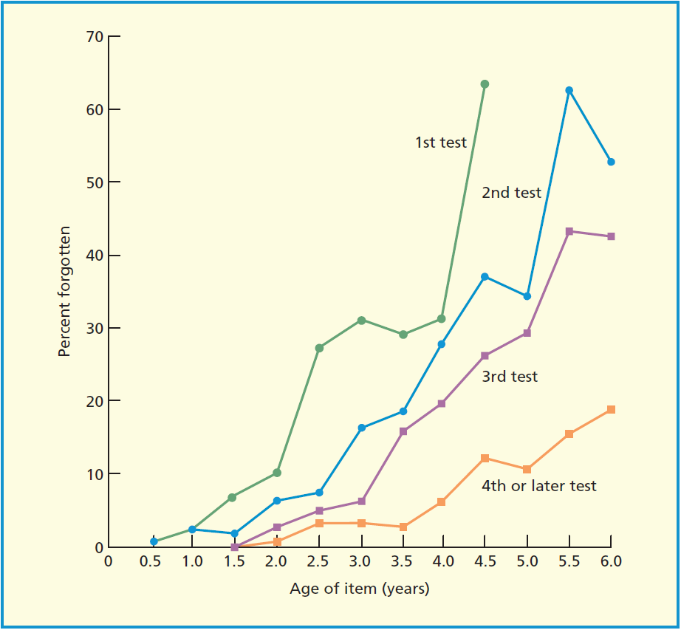
Linton (1975). In Norman & Rumelhart, Explorations in cognition.

Slide 16
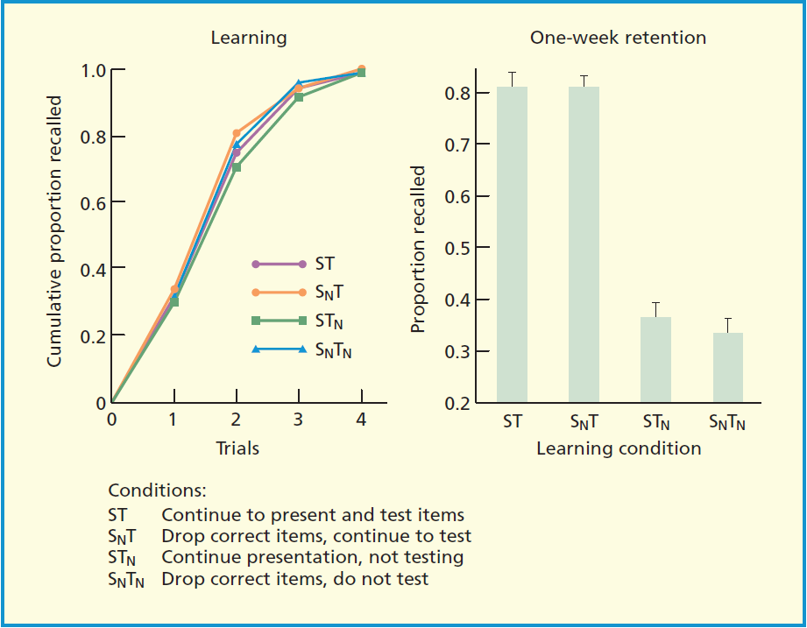
Karpicke & Roediger (2008). Science, 319, 966

Slide 17
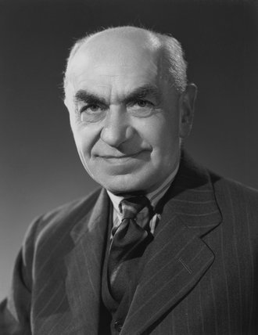
Hermann Ebbinghaus
(1850 – 1909)
Sir Frederic Bartlett
(1886 – 1969)

Slide 18
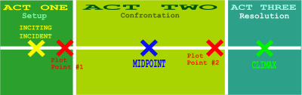

Slide 19
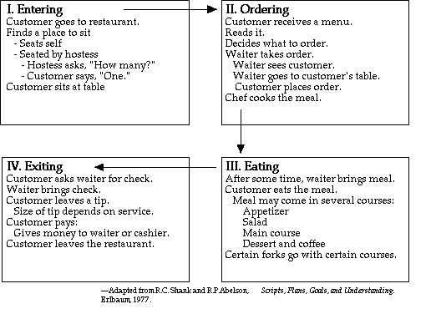
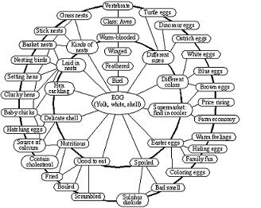

Slide 20
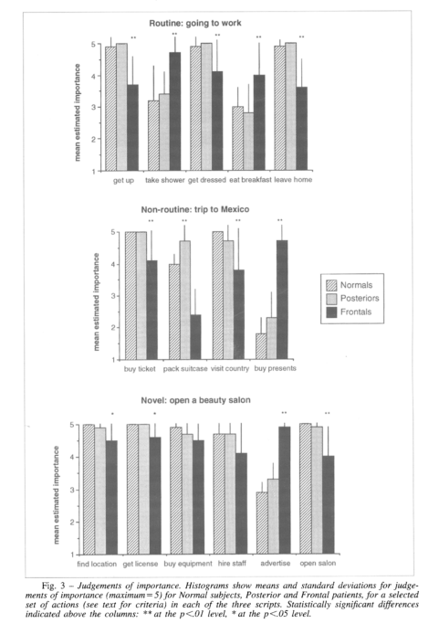
Sirigu et al. (1995).Cortex, 31, 301

Slide 21
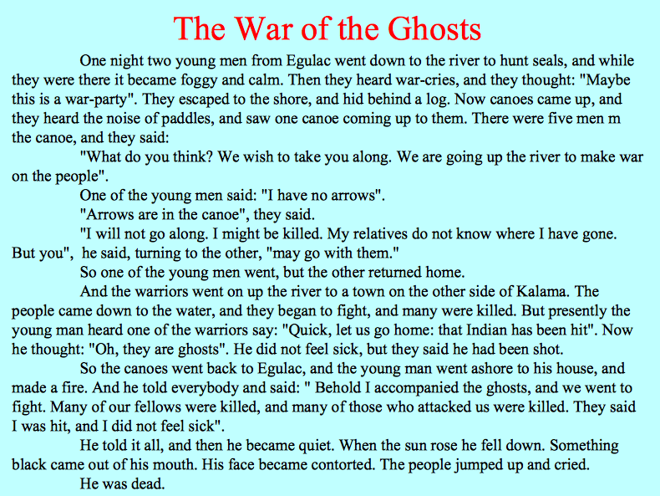
Sir Frederic Bartlett

Slide 22
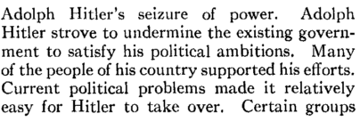
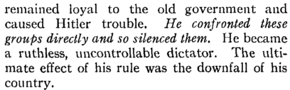
Sulin & Dooling (1974). Journal of Experimental Psychology, 103, 255

Slide 23
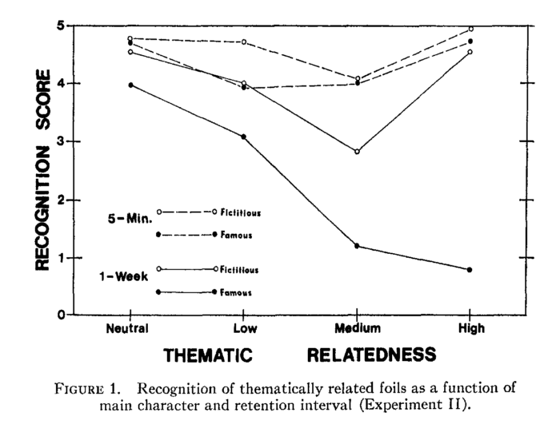
Sulin & Dooling (1974). Journal of Experimental Psychology, 103, 255

Slide 24
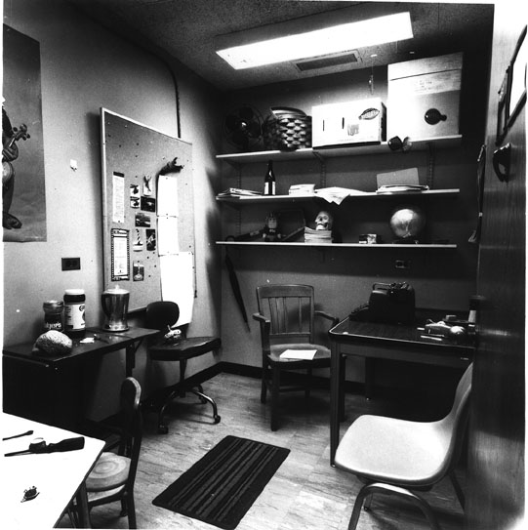
Brewer & Treyens (1981). Cognitive Psychology, 13, 207

Slide 25
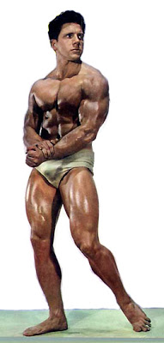
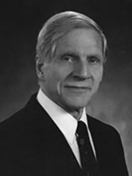
Allen Paivio
Dual-coding hypothesis (1969)

Slide 26
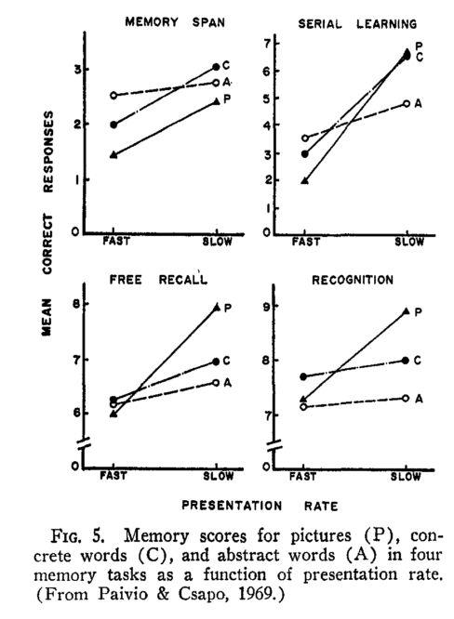
Paivio (1969). Psychological Review, 76, 241

Slide 27
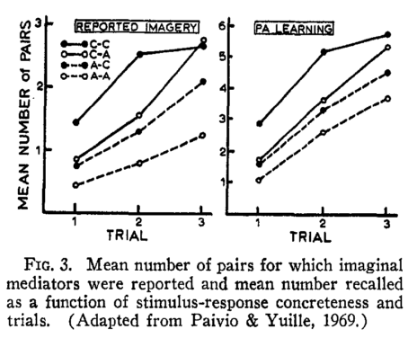
Paivio (1969). Psychological Review, 76, 241
Notes:
Liste I : Vertue, histoire, silence, vie

Slide 28
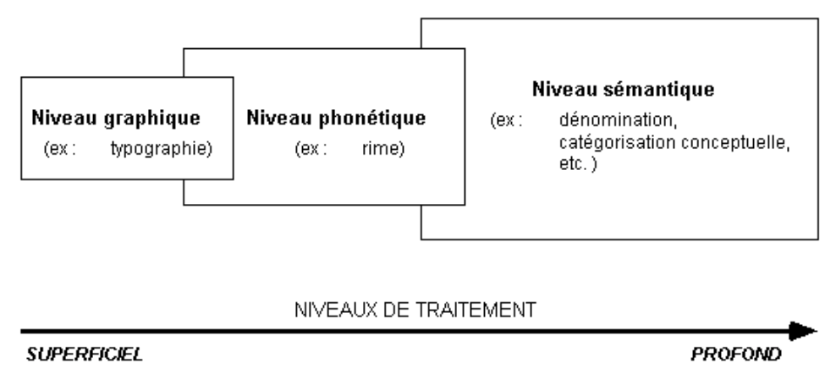
Craik & Lockhart (1972) – THEORIE DES NIVEAUX DE TRAITEMENT

Slide 29
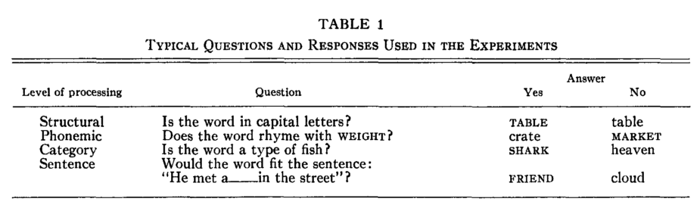
Craik & Tulving (1975). Journal of Experimental Psychology: General, 104, 268

Slide 30
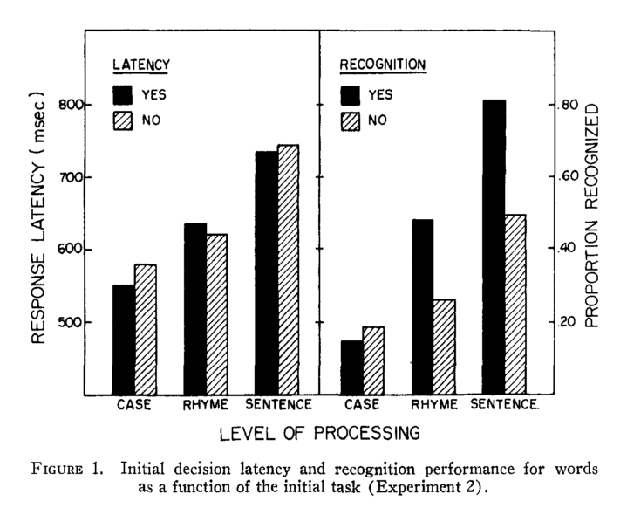
Craik & Tulving (1975). Journal of Experimental Psychology: General, 104, 268

Slide 31
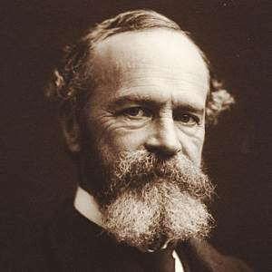
“The one who thinks over his experiences
most, and weaves them into systematic
relations with each other will be the one
with the best memory… All improvement in
memory lies in the line of elaborating the
associates”
William James (1890). Principles of Psychology

Slide 32
Rappel libre
2
6
18
1 mot
11%
7%
12%
3 mots
3%
4%
5%
Reconnaissance
Glenberg, Smith, & Green (1977). Journal of Verbal Learning and Verbal Behavior, 16, 339

Slide 33
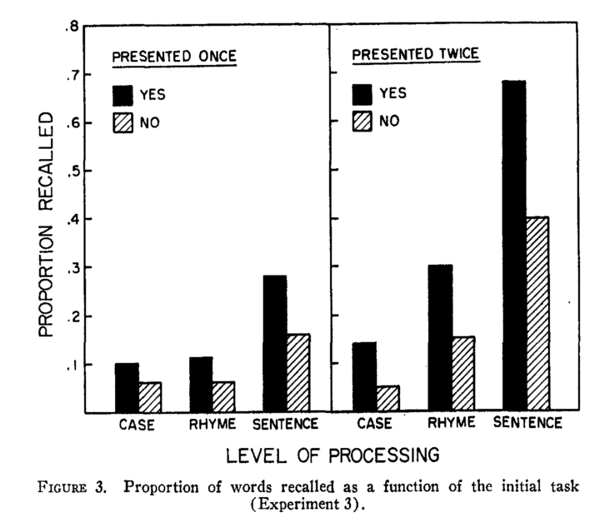
Craik & Tulving (1975). Journal of Experimental Psychology: General, 104, 268

Slide 34
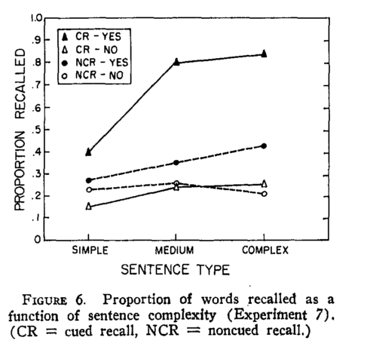
Craik & Tulving (1975). Journal of Experimental Psychology: General, 104, 268

Slide 35
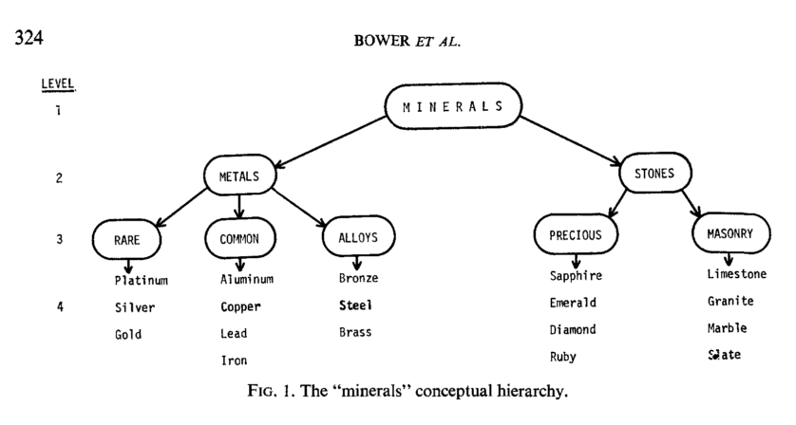
Bower et al. (1969). Journal of Verbal Learning and Verbal Behavior, 8, 323

Slide 36
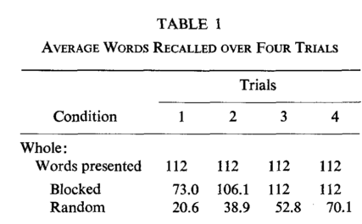
Bower et al. (1969). Journal of Verbal Learning and Verbal Behavior, 8, 323

Slide 37
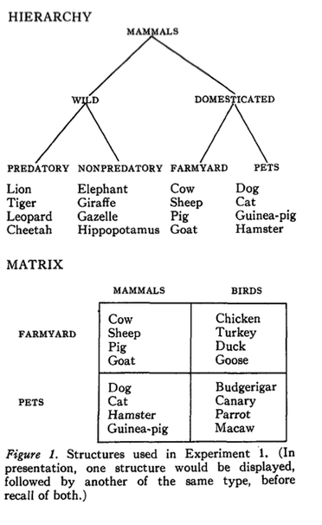
Broadbent et al. (1978). Journal of Experimental Psychology: Human Learning and Memory, 4,486

Slide 38
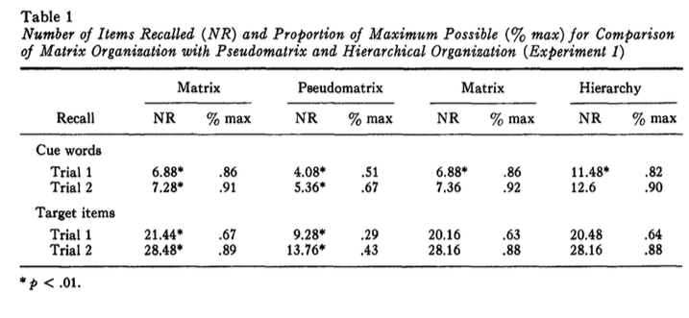
Broadbent et al. (1978). Journal of Experimental Psychology: Human Learning and Memory, 4,486

Slide 39
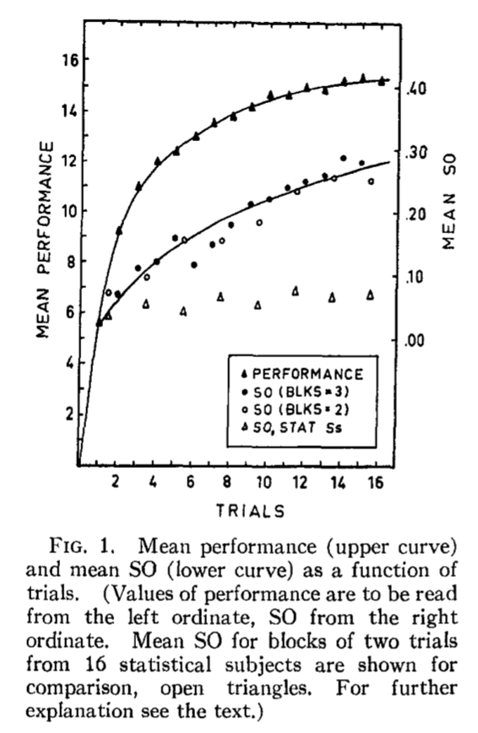
Tulving (1962).Psychological Review, 69, 344

Slide 40
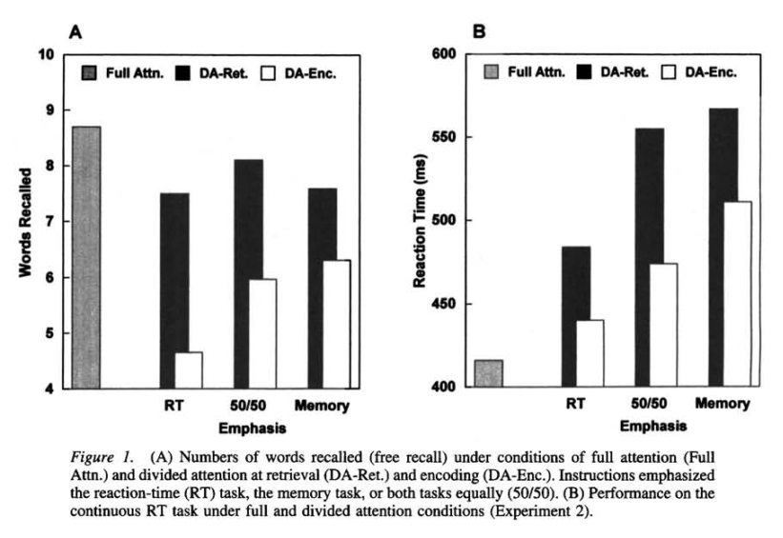
Craik et al. (1996). Journal of Experimental Psychology: General, 125, 159

Slide 41
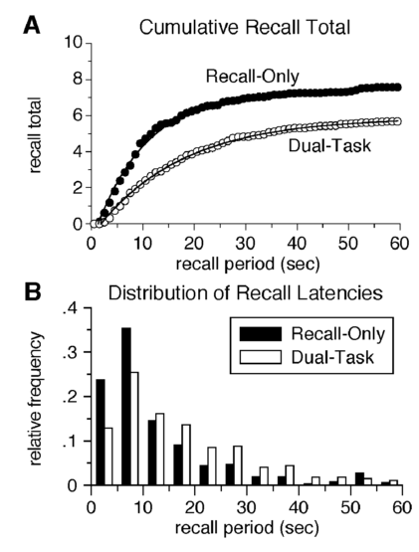
Rohrer & Pashler (2003). Psychonomic Bulletin and Review, 10, 96

Slide 42
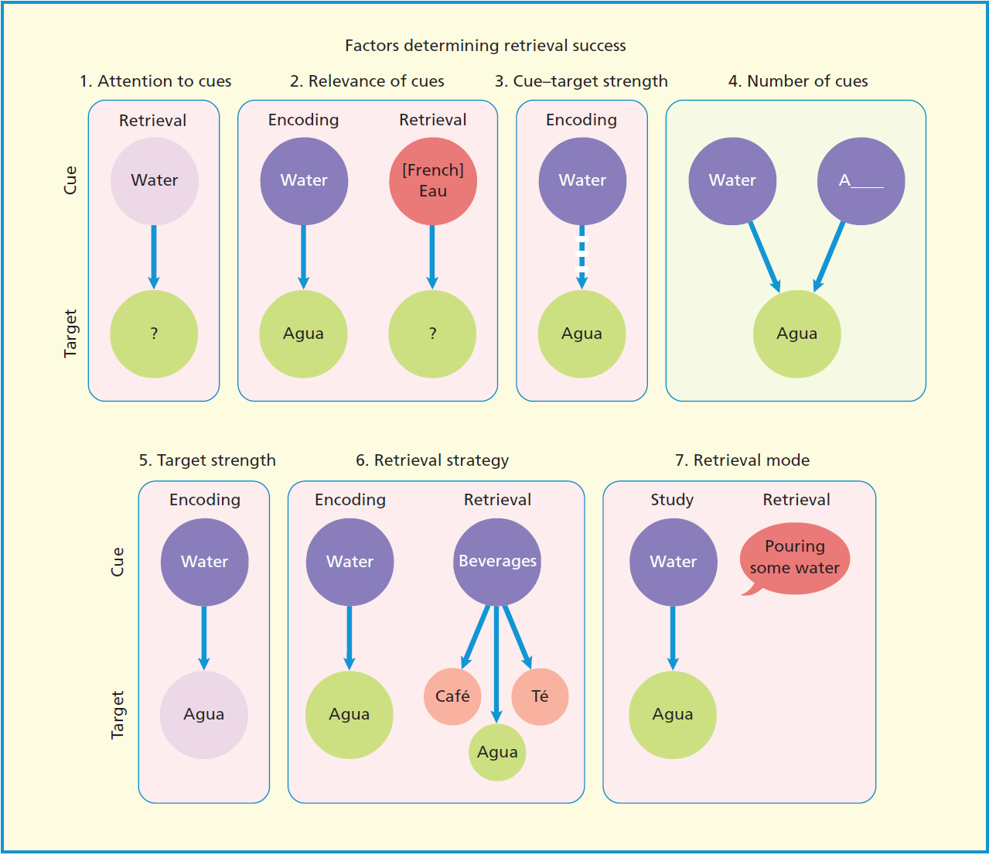

Slide 43
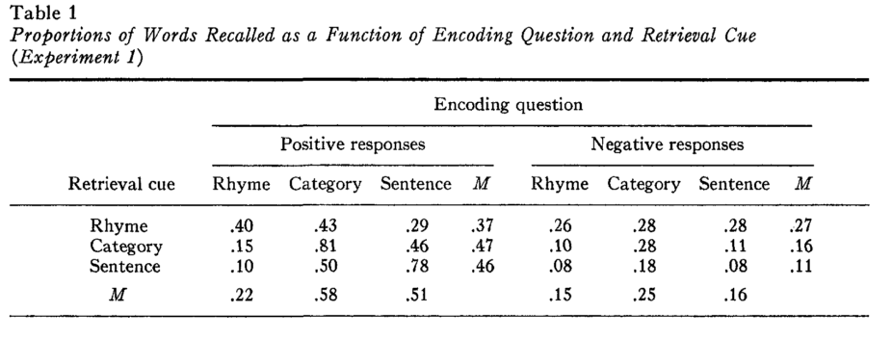
Fisher & Craik (1977). Journal of Experimental Psychology: Human Learning and Memory, 3, 701

Slide 44
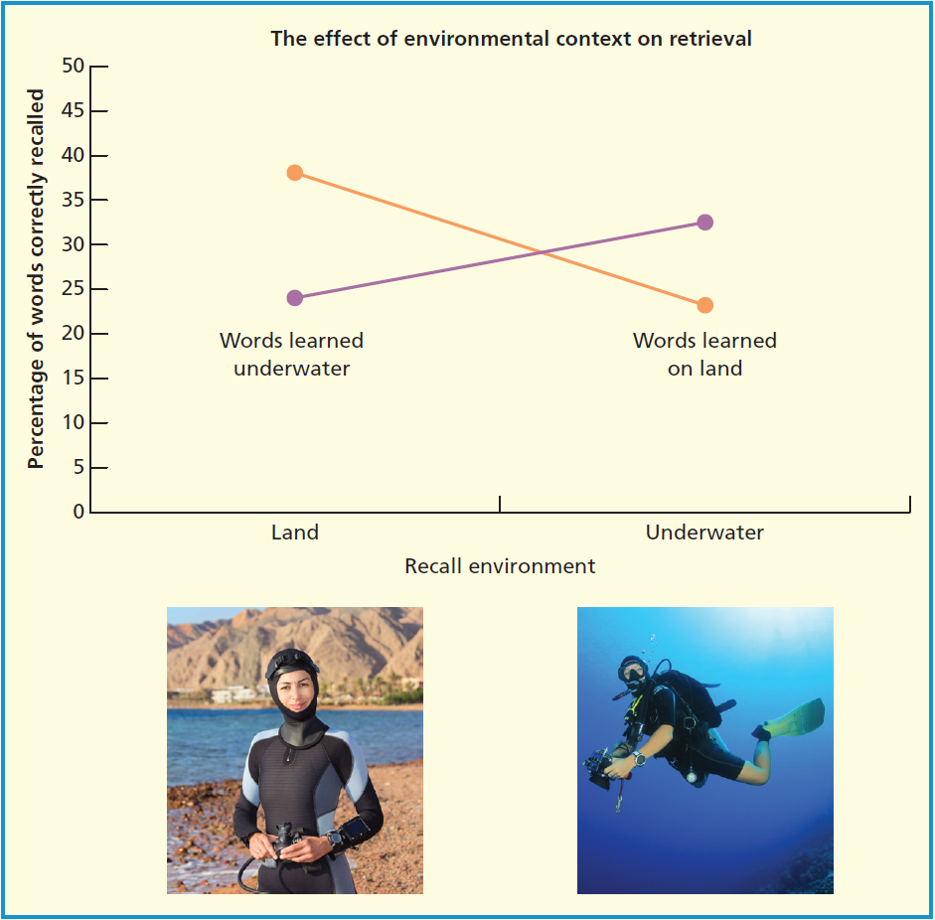
Godden & Baddeley (1975). British Journal of Psychology, 66, 3

Slide 45
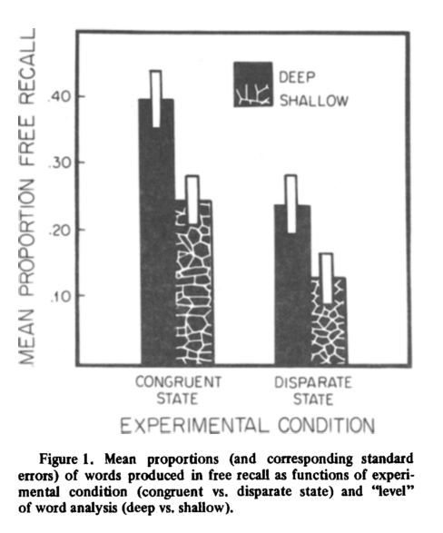
Eich (1980). Memory & Cognition, 8, 157

Slide 46
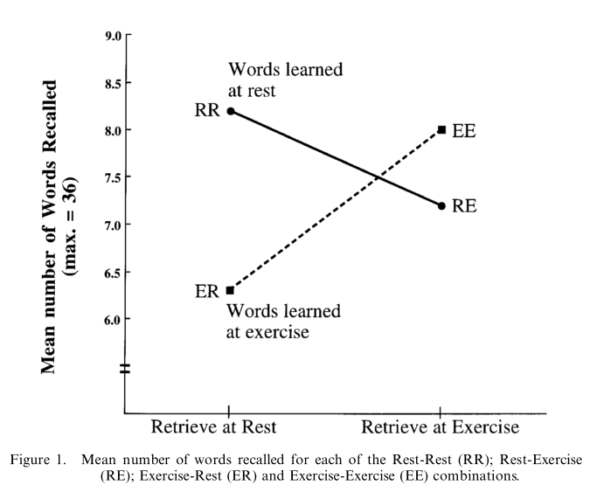
Miles & Hardman (1998). Ergonomics, 8, 157

Slide 47
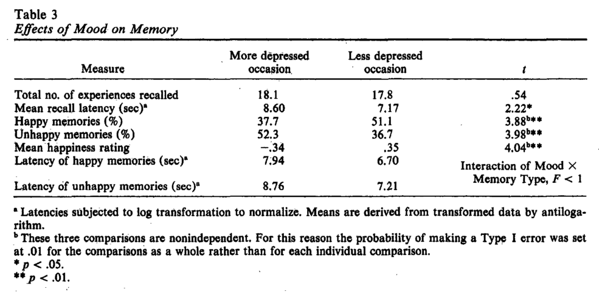
Clark & Teasdale (1982). Journal of Abnormal Psychology, 91, 87

Slide 48
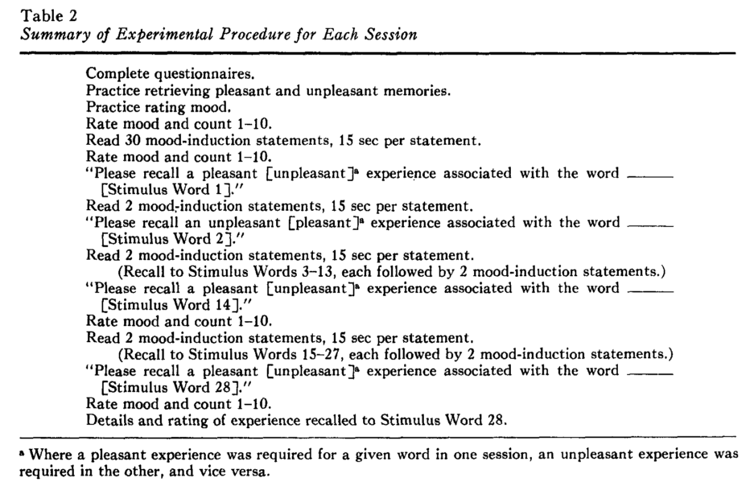
Teasdale & Forgaty (1979). Journal of Abnormal Psychology, 88, 248

Slide 49
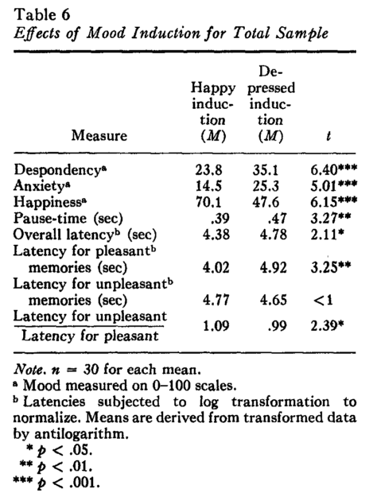
Teasdale & Forgaty (1979). Journal of Abnormal Psychology, 88, 248

Slide 50

Eich et al. (1994). Journal of Experimental Psychology: General, 123, 201

Slide 51

Anderson & Pritchert (1978). Journal of Verbal Learning and Verbal Behavior, 17, 1

Slide 52


Marian & Neisser (2000). Journal of Experimental Psychology: General, 129, 361

Slide 53

Marian & Fossey (2006). Applied Cognitive Psychology, 20, 1025

Slide 54

Smith & Vela (2001). Psychonomic Bulletin & Reviews, 8, 203

Slide 55

Fernandes & Moscovitch (2000). Journal of Experimental Psychology: General, 129, 155

Slide 56
Craik et al. (1996). Journal of Experimental Psychology: General, 125, 159

Slide 57

Fernandes & Moscovitch (2000). Journal of Experimental Psychology: General, 129, 155

Slide 58


Brown & McNeil (2000).Journal of Verbal Learning and Verbal behavior 5, 325

Slide 59

Gorman (1961). Journal of Experimental Psychology 61, 23-29

Slide 60


Yonelinas (2002). Journal of memory and language, 46,, 411.

Slide 61

Eldridge et al. (2000). Nature Neuroscience, 3,, 1149.

Slide 62


Montalbi et al. (2006). Hippocampus, 16, 504

